Slide 1
What’s the Point? Turning Complex Analyses into Actionable Stories
Benjamin Burch, PhD
Carthage Guest Lecture
April 29, 2025
benjaminburch@gmail.com
https://www.linkedin.com/in/benjaminburch/

Slide 2

Hi! I’m Ben — a Carthage College graduate who started out pre-med somehow stumbled into math, physics, and a career in data science. Today, I lead a team at Midwest Employers Casualty (a Berkley Company), building machine learning and AI tools that help insurance professionals identify the best course of action for employees injured on the job. One of my favorite projects? Using deep learning to create a custom Natural Language Processing model to recognize medications across thousands of millions pages of messy claims documentation. Before jumping into industry, I earned my PhD in Physics at Washington University in St. Louis where I studied dark matter, cosmic rays and bubble. I also taught a few courses on SQL at Maryville University along the way. I'm excited to be back at Carthage — and even more excited to help you think about how you can turn your analysis into stories that drive action.

Slide 3
Outline
Why Data Visualization Matters
Cognitive Load & Visual Perception
Gestalt Principles of Visual Grouping
Data Storytelling Techniques
Visualization Do’s and Don’ts
Tools of the Trade

Slide 4
Why Data Visualization Matters
Enables pattern recognition and comparison
Reveals trends, outliers, and relationships not visible in raw tables
Helps bridge the gap between technical analysis and business decisions
Empowers audiences — technical or not — to ask better questions

Slide 5

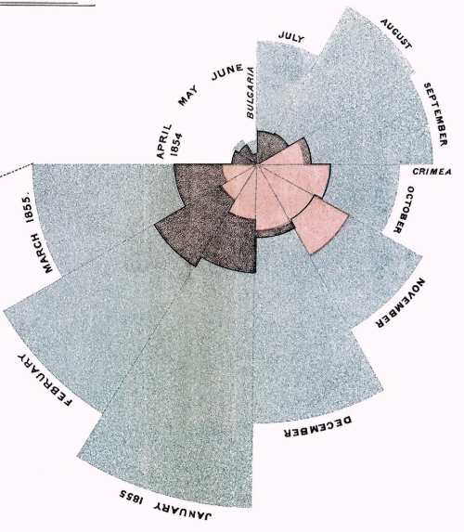
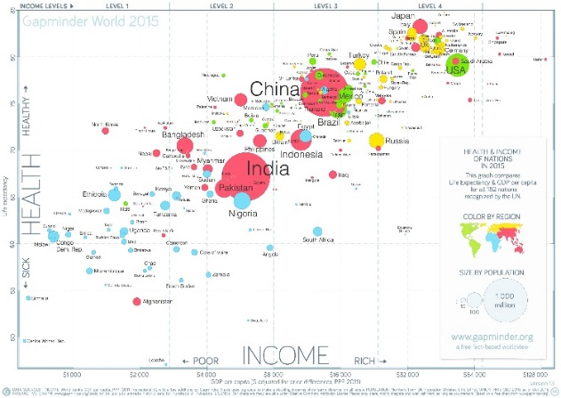
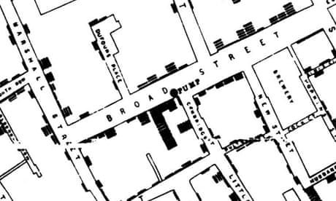
Good Visuals Drive Action
Florence Nightingale’s 1858 coxcomb diagram
John Snow’s 1854 cholera map
Hans Rosling’s 200 Countries, 200 Years, 4 Minutes Bubble chart

Slide 6
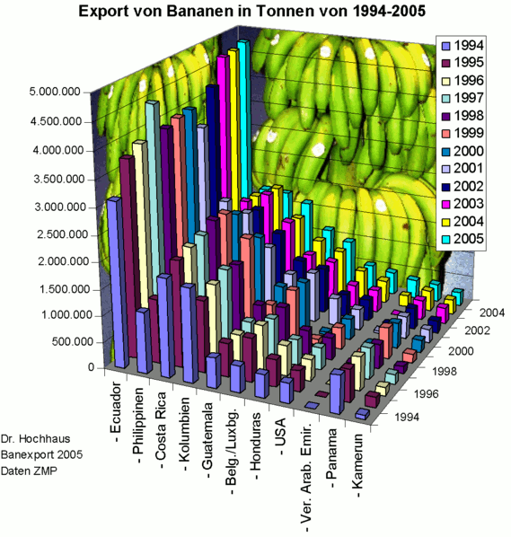
Bad Visuals are Confusing!
Did the USA or Honduras export more bananas in 2001?
Did the UAE export more of fewer bananas between 1996 and 1998?
Approximately how many bananas were exported by Columbia in 1999?
How does the Philippines compare to Columbia?

Slide 7
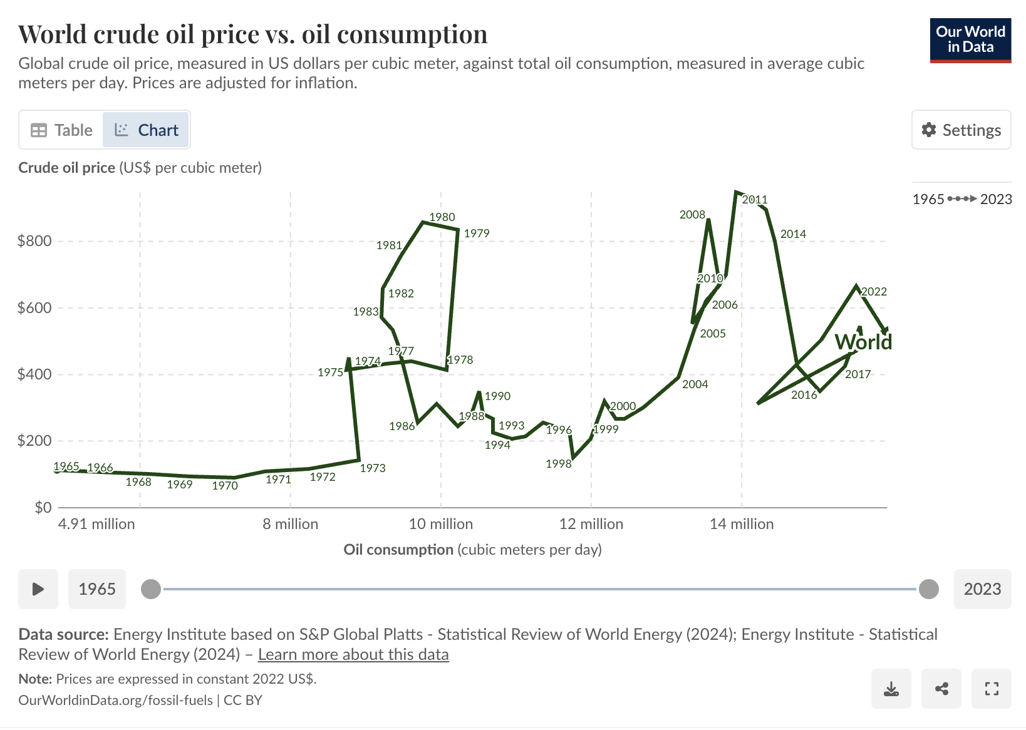
Bad Visuals are Confusing!

Slide 8
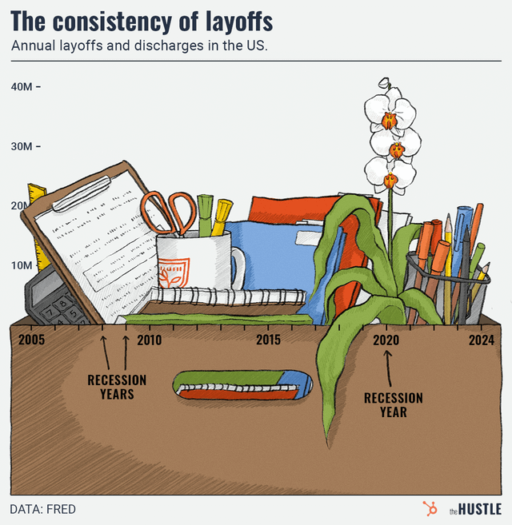
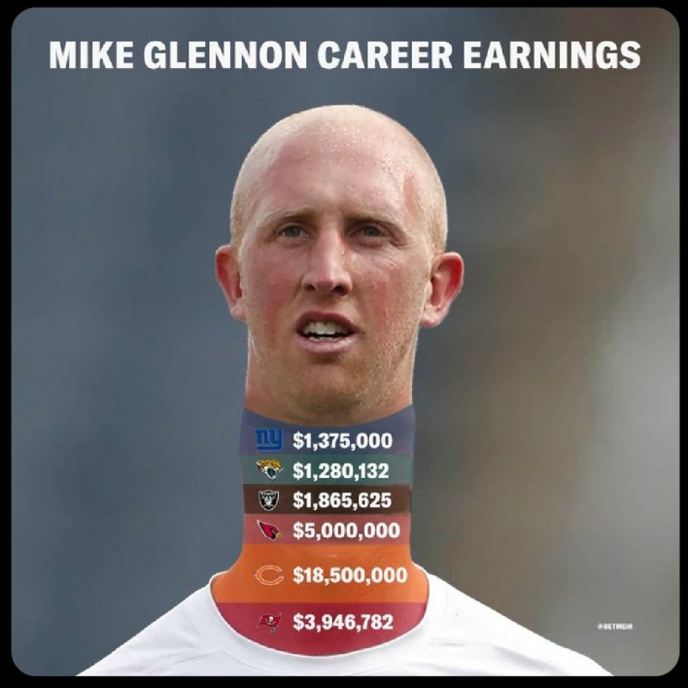
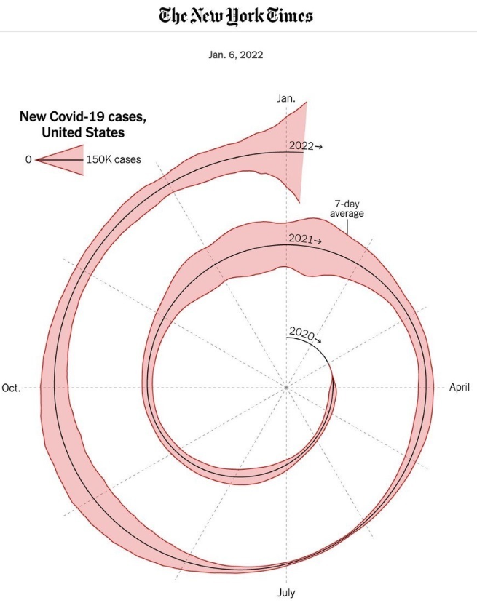
Bad Visuals are Confusing!

Slide 9

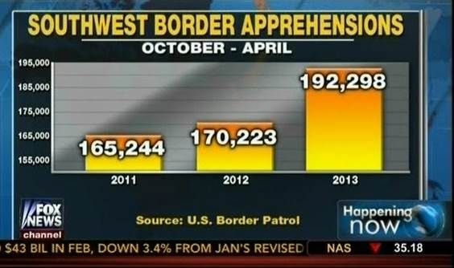
Worse, Bad Visuals Lead to Misinformation!
Florida Gun Deaths
Immigration Enforcement

Slide 10
How do we make good visuals?
Reduce Cognitive Load
Leverage Gestalt Principles of Visual Grouping
Follow Data Story Telling Best Practices
Don’t Over-Complicate Things!
LEARN MORE HERE

Slide 11


Cognitive Load
Intrinsic Load
The complexity of the data itself
Examples:
High-dimensional datasets
Unfamiliar metrics
Non-standard graph types
Extraneous Load
Unnecessary cognitive effort caused by poor visual design
Examples:
3D charts
Unclear color schemes
Wrong graph type
Germane Load
Efforts that help the audience learn and understand
Examples:
Highlighting key insights
Annotations and data labels
Building narrative
Good visualizations reduce extraneous load and promote germane load.
LEARN MORE HERE

Slide 12
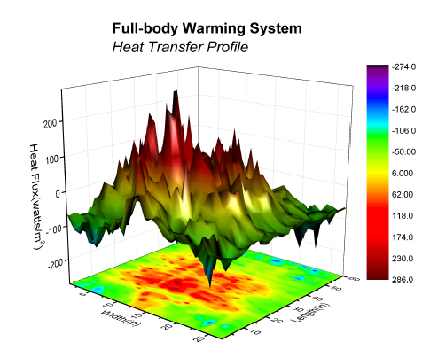
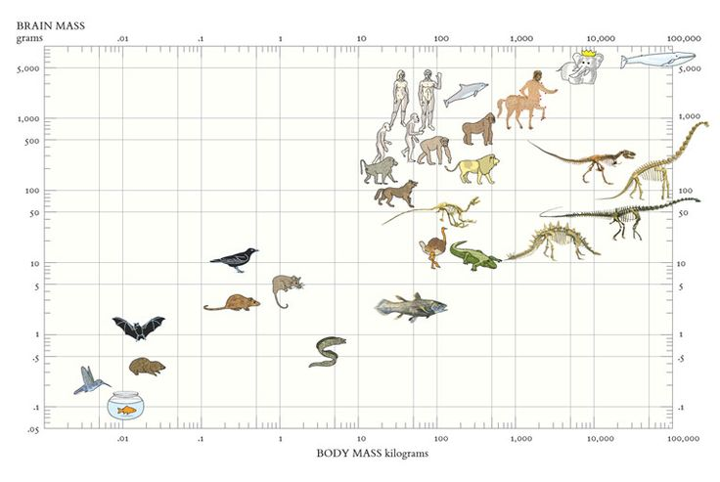
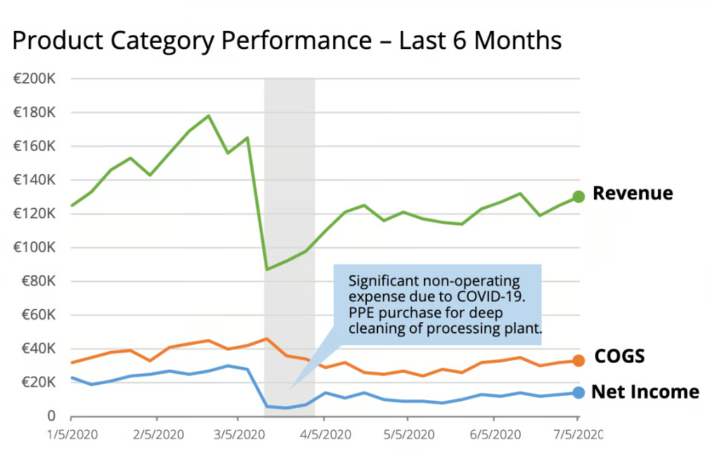
Cognitive Load
Intrinsic Load
Extraneous Load
Germane Load
Analytical Graph
Cutesy Chart Junk
Explanatory Graph
Good visualizations reduce extraneous load and promote germane load.
LEARN MORE HERE

Slide 13
Strategies for Reducing Cognitive Load
Principle | What It Means | Example
Minimize clutter | Avoid chart junk | Remove unnecessary gridlines, colors, reduce unneeded categories
Use pre-attentive attributes | Leverage color, shape, size | Highlight key line in a line chart
Group related elements | Align with Gestalt | Put labels close to data points Use similar colors for similar data
Progressive disclosure | Don’t show everything at once | Dashboard tabs or filters, data stories

Slide 14
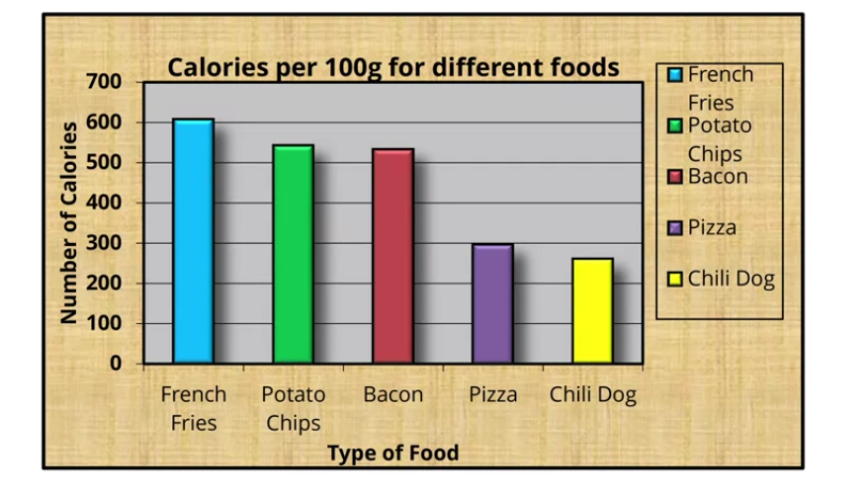
Chart Junk
Chart Junk is any visual element of a graph that is not necessary to understand the information represented on the graph.

Slide 15
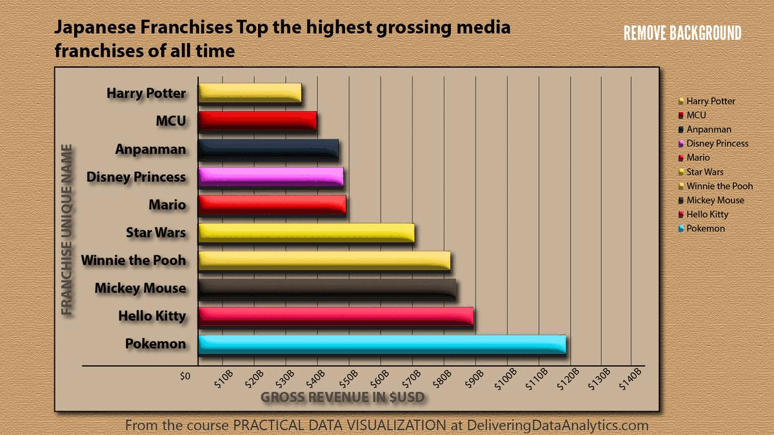
LEARN MORE HERE

Slide 16
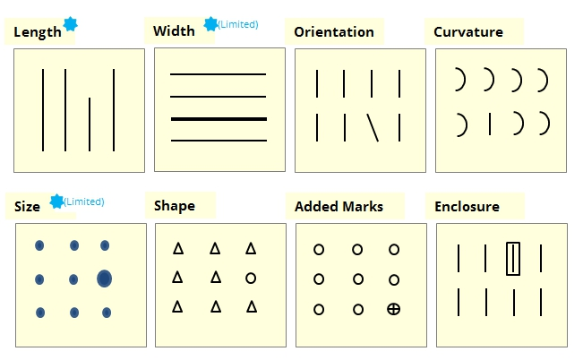
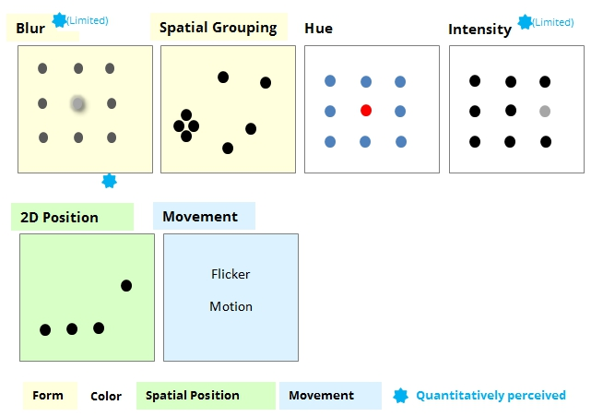
Pre-attentive Attributes
Pre-attentive attributes are visual properties that the human brain processes almost instantly, without conscious effort.
LEARN MORE HERE

Slide 18
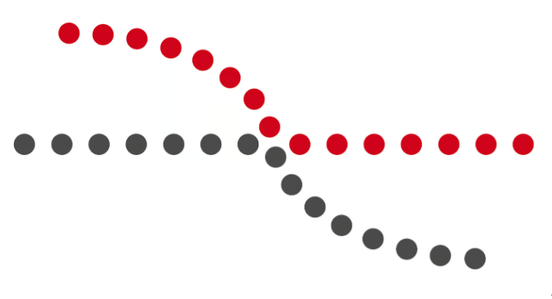
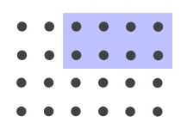


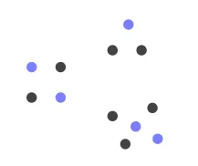
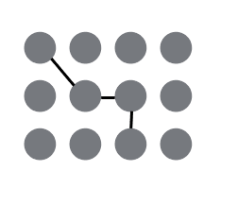
Gestalt Principles
Gestalt principles describe the subconscious rules our brain uses to spot patterns—why spacing, color, shape, and lines in a chart instantly snap separate marks into meaningful groups before we even think about it.
Closure
Continuity
Enclosure
Proximity
Similarity
Connection
LEARN MORE HERE!

Slide 20
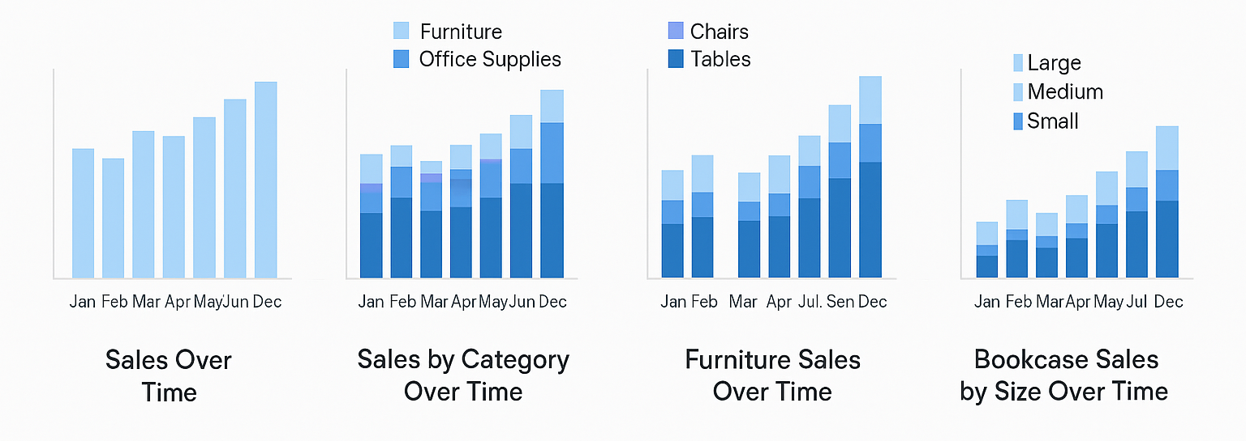
Progressive Disclosure
Tell a story!

Slide 21
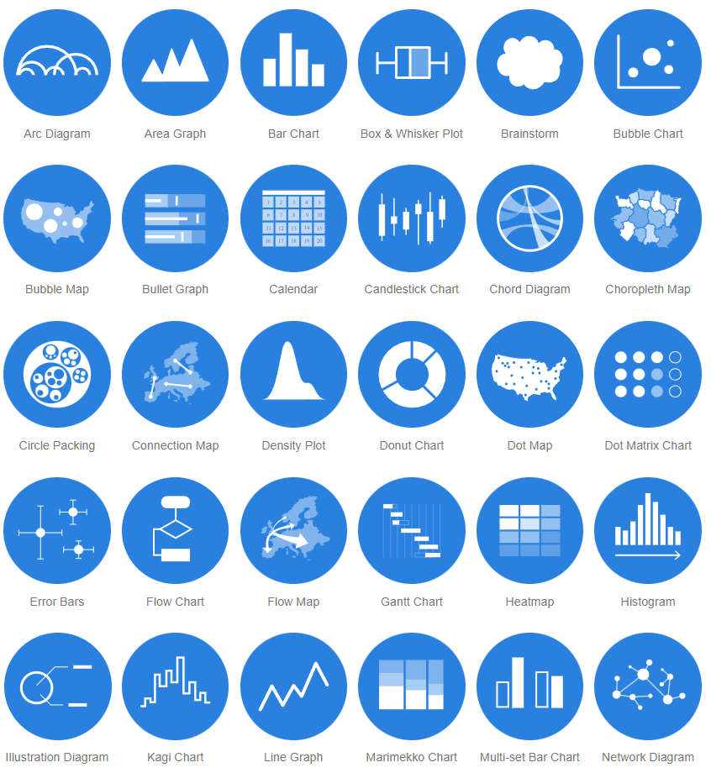
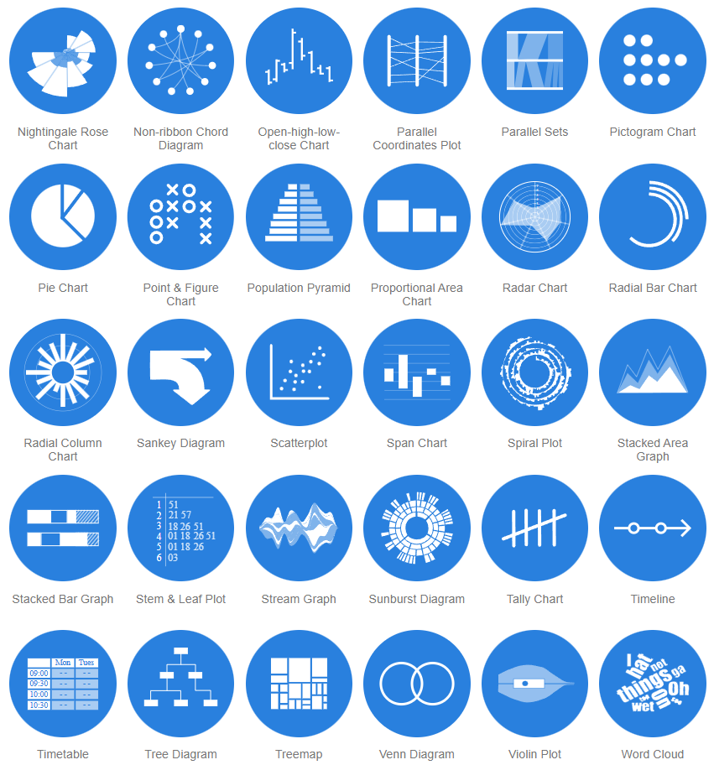
Match your visual to your message
LEARN MORE HERE

Slide 22
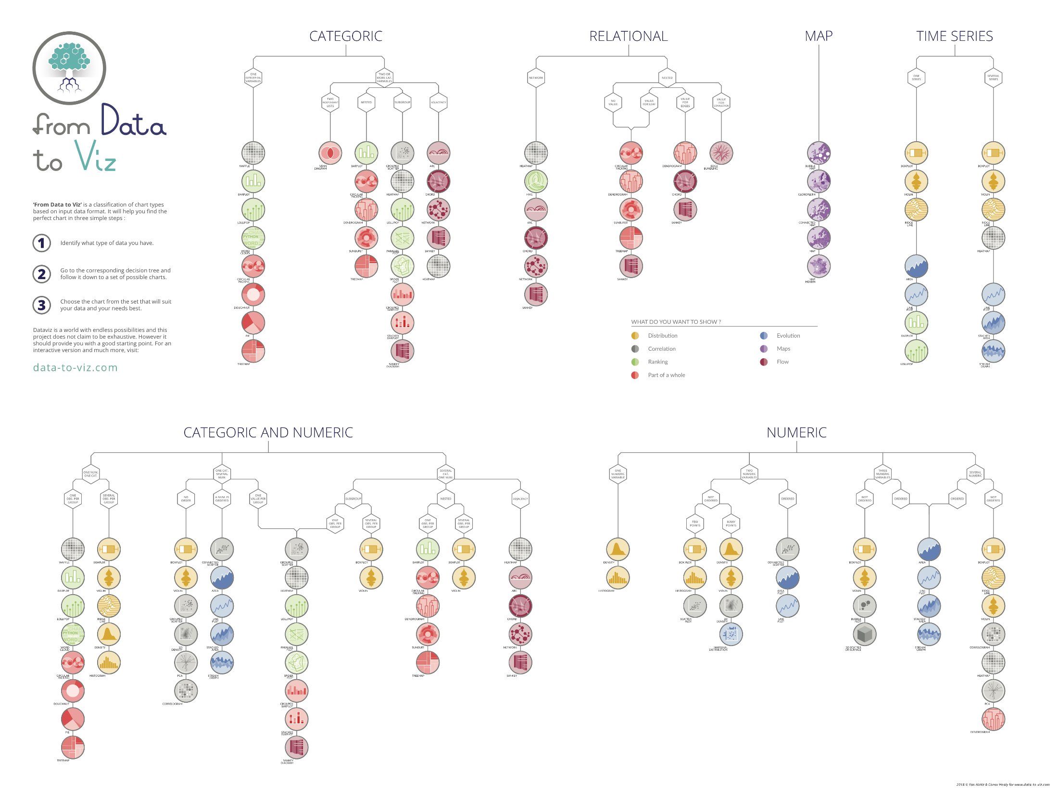




How to choose?
LEARN MORE HERE
AND HERE

Slide 23
Data Storytelling
What Makes a Data Story
Data Foundation
Main Point
Explanatory Focus
Linear Sequence
Dramatic Elements
Visual Anchors
How do you do it?
Get the Right Data
Create the Right Visualizations
Put them in the Right Order
Remove Noise
Focus Attention
Make it Approachable
Instill Trust
LEARN MORE HERE!
AND HERE!

Slide 24
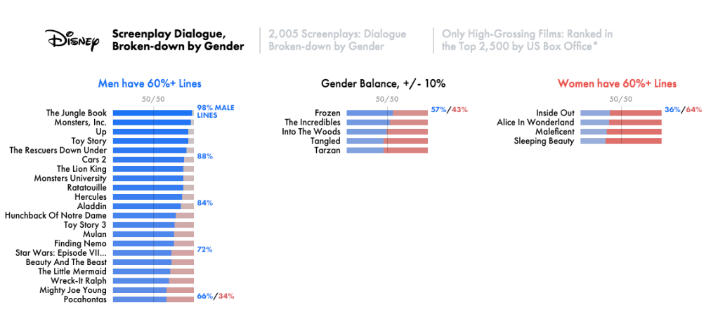

Slide 25


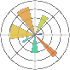












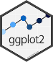

Tools of the Trade
Python
Matplotlib
Bokeh
Altair
Seaborn
Streamlit (apps)
Gradio (apps)
R
Built-in graphics library
ggplot2
Shiny (apps)
Python and R
Plotly
Dash (apps)
Javascript
D3
Other
PowerBI (dashboards)
Tableau (dashboards)

Slide 26
Putting it All Together

